Slide 1

Plant Disease Detection and Classification with Pesticides Suggestions For E-Agriculture Application
Under the guidance of : Dr . J. Srikanth
By
V. Retesh Kumar (19RA1A0530)
L.V.N.S. Goutham (19RA1A0550)
V. Yuva raj (20RA5A0510)

Slide 2
ABSTRACT
Plant diseases are a major threat to farmers, consumers, environment and the global economy. In India alone, 14% of field crops are lost to pathogens and pests causing losses to farmers. Indiscriminate use of pesticides is also a serious health concern as many are toxic and biomagnified. These adverse effects can be avoided by early disease detection, crop surveillance and targeted treatments.
Most diseases are diagnosed by agricultural experts by examining external symptoms. However, farmers have limited access to experts. Farmers can identify diseases and get solutions with a web application by photographing affected plant parts.

Slide 3
INTRODUCTION
Modern technologies have given human society the ability to produce enough food to meet the demand of more than 7 billion people. However, food security remains threatened by a number of factors including climate change, plant diseases, and others
In the developing world, more than 80 percent of the agricultural production is generated by smallholder farmers, and reports of yield loss of more than 50% due to pests and diseases are common.
Furthermore, the largest fraction of hungry people (50%) live in smallholder farming households, making smallholder farmers a group that's particularly vulnerable to pathogen-derived disruptions in food supply.

Slide 4
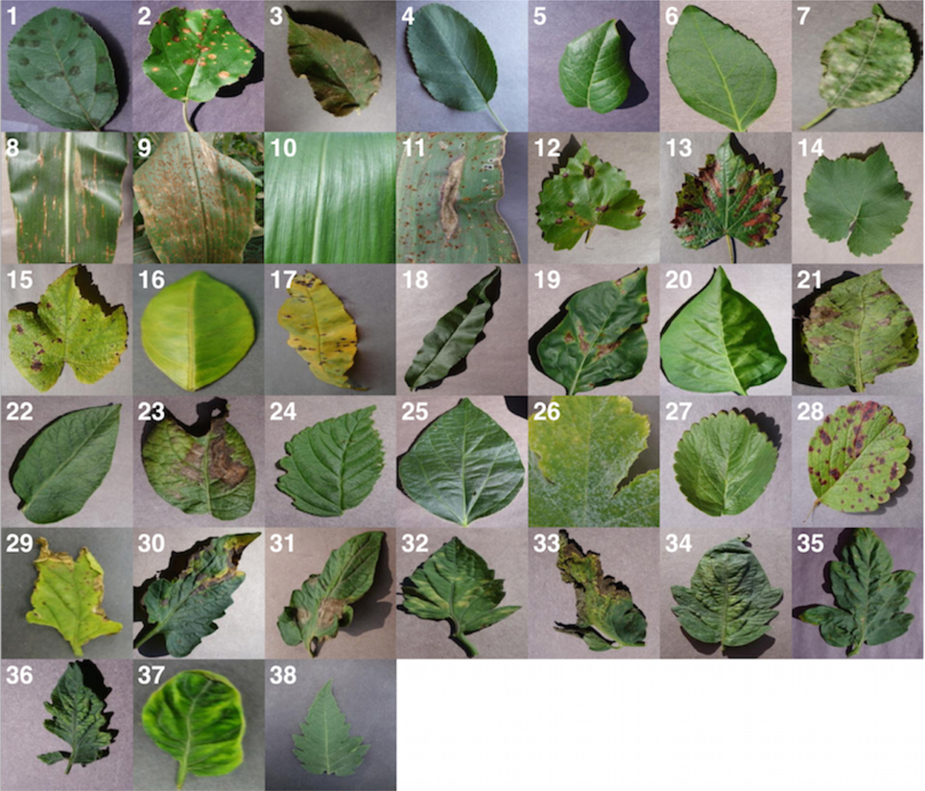

Slide 5
LITERATURE SURVEY
proposed a recognition system of images for plant species which can be identified automatically namely Leaf Snap. They built a mobile app that assists users to recognize trees by capturing photos of their leaves and their current version covers all species of the given dataset. Their recognition process mainly consists of four parts - classifying, segmenting, extracting and comparing. Furthermore, they followed nearest neighbours (NN) approach for identification of leaf type. Sue Han et al.

Slide 6
EXISTING SYSTEM
K-Nearest Neighbour (KNN) Algorithm
K-Nearest Neighbour is one of the simplest Machine Learning algorithms based on Supervised Learning technique.
K-NN algorithm assumes the similarity between the new case/data and available cases and put the new case into the category that is most similar to the available categories.
K-NN algorithm stores all the available data and classifies a new data point based on the similarity. This means when new data appears then it can be easily classified into a well suite category by using K- NN algorithm.
K-NN is a non-parametric algorithm, which means it does not make any assumption on underlying data.

Slide 7
Drawbacks of existing system
Accuracy depends on the quality of the data.
With large data, the prediction stage might be slow.
Sensitive to the scale of the data and irrelevant features.
Require high memory – need to store all of the training data.
Given that it stores all of the training, it can be computationally expensive.

Slide 8
PROPOSED SYSTEM
RESNET
ResNet, short for Residual Network is a specific type of neural network that was introduced in 2015 “Deep Residual Learning for Image Recognition”.
The ResNet models were extremely successful.
CNN involves in allowing every source data via a succession of convolution layers by a kernel
Convolution layer is the primary layer to extract the features from a source image and maintains the relationship between pixels by learning the features of image by employing tiny blocks of source data.

Slide 9
PROPOSED SYSTEM(cont)
Efficiently trained networks with 100 layers and 1000 layers also.
Mostly in order to solve a complex problem, we stack some additional layers in the Deep Neural Networks which results in improved accuracy and performance.
Won 1st place in the ILSVRC 2015 classification competition with a top-5 error rate of 3.57% (An ensemble model)

Slide 10
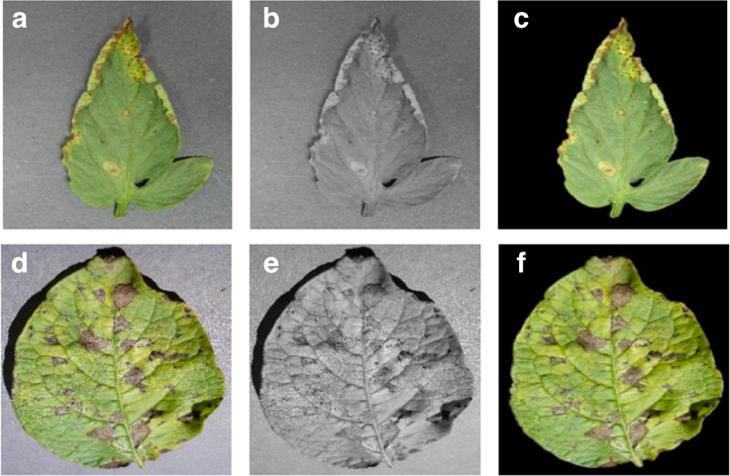

Slide 11
ADVANTAGES OF PROPOSED SYSTEM
More Accuracy in image processing.
Increase in accuracy of results.
It requires less training data.
More data processing can be done.
Therefore, speed of execution gets decreased.

Slide 12
SYSTEM REQUIREMENTS
SOFTWARE REQUIREMENTS
The functional requirements or the overall description documents include the product perspective and features, operating system and operating environment, graphics requirements, design constraints and user documentation.
Operating system : Windows 11
Languages : Python 3
Editor : Tickner web ui
Tool Kit : NLTK

Slide 13
HARDWARE REQUIREMENTS
Minimum hardware requirements are very dependent on the particular software being developed by a given Enthought. Applications that need to store large arrays/objects in memory will require more RAM, whereas applications that need to perform numerous calculations or tasks more quickly will require a faster processor.
Operating system : Windows
Processor : intel i5
Ram : 4 GB
Hard disk : 250GB

Slide 14
UML Diagrams
Class Diagram
Sequence Diagram
Activity Diagram
Deployment Diagram
Use Case Diagram
Component Diagram

Slide 15
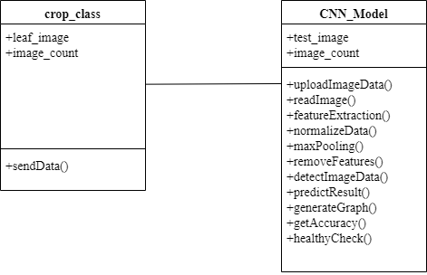
Class Diagram

Slide 16
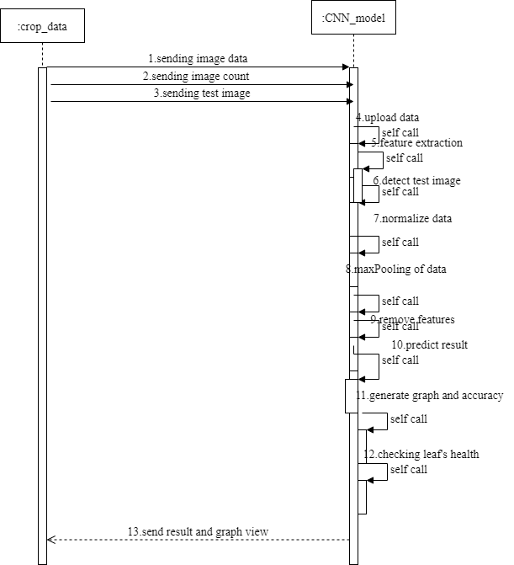
Sequence Diagram

Slide 17
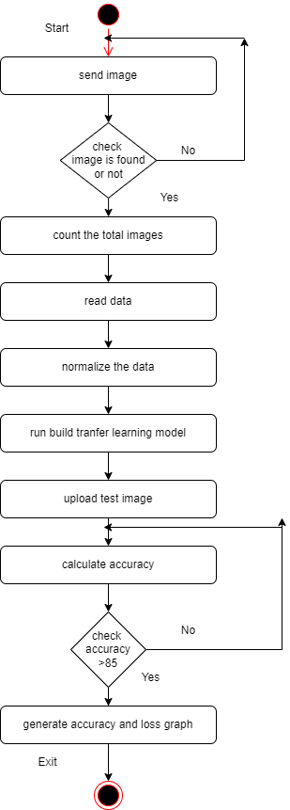
Activity Diagram

Slide 18
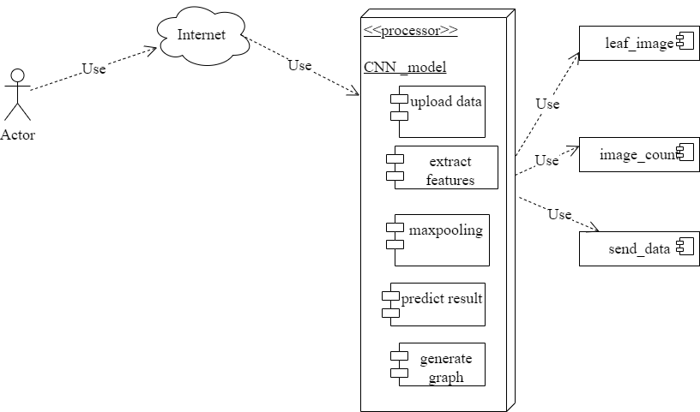
Deployment Diagram

Slide 19
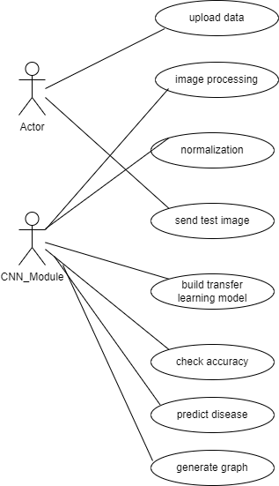
Use Case Diagram

Slide 20
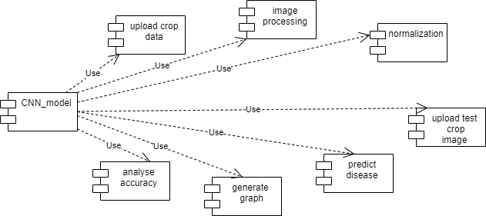
Component Diagram

Slide 21
Pseudocode
Step:1- import necessary modules tkinter mat.lib, numpy, keras
Step:2- create main window using tkinter.
Step:3-Define global variables to store the dataset, image labels, filename, model, and accuracy.
Step 4 : Define functions to upload the dataset, process the images, train the CNN model, and predict the disease of a plant image.
Step 5 : In the upload Dataset() function, the script asks the user to select a directory containing the images for the dataset and then loads the images and labels into global variables X and Y, respectively.
Step6 : In the imageProcessing() function, the script normalizes the images in X, shuffles the indices of the images and their labels, and displays an example image.

Slide 22
Pseudocode cont.
Step 7 : Inside the cnnModel() function, the script checks whether a saved CNN model exists in the 'model' directory. If the saved model exists, it loads the model and its weights, and the accuracy from a saved history file. If the saved model does not exist, it builds a new CNN model using keras, trains it on the dataset, saves the model and its weights, and saves the accuracy history to a file.
Step 8 : Inside the predict() function, the script asks the user to select an image file to predict its disease, and then loads the image, resizes it to 64x64, and preprocesses it. It then predicts the disease of the image using the trained CNN model and displays the prediction using tkinter messagebox.

Slide 23
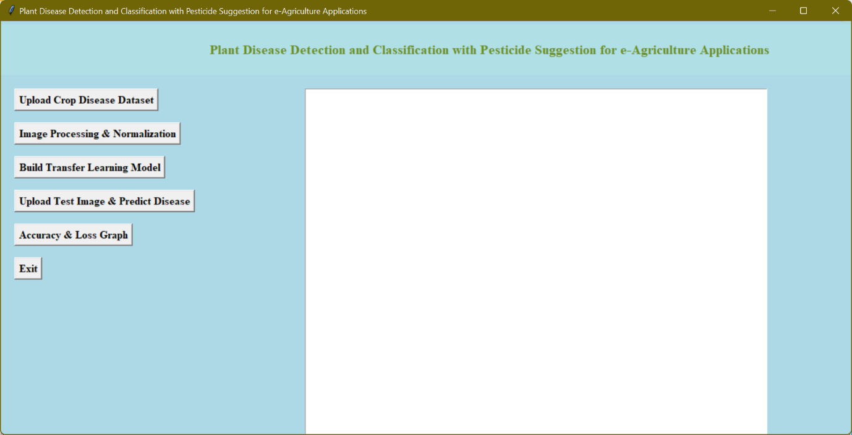
Screenshots
To run project double click on ‘run.bat’ file.
In above screen click on ‘Upload Crop Disease Dataset’ button to upload dataset images

Slide 24
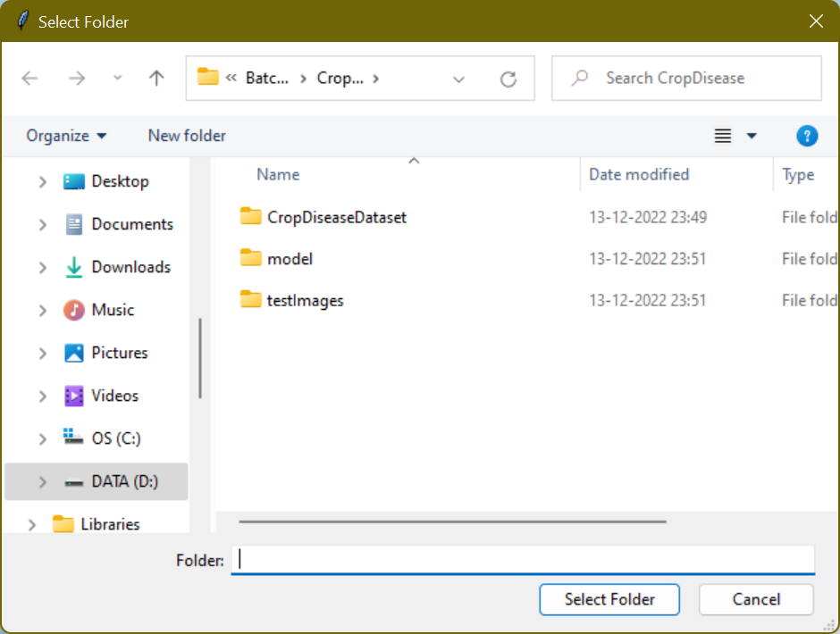
In above screen selecting and uploading ‘CropDiseaseDataset’ folder and then click on ‘Select Folder’ button to load dataset and to get below screen

Slide 25
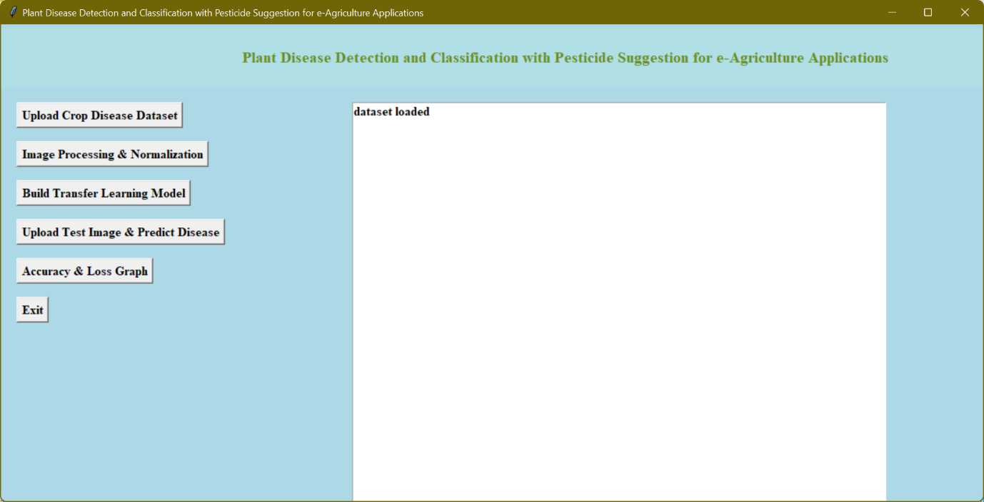
In above screen dataset loaded and now click on ‘Image Processing & Normalization’ button to read all images and then process images to normalize by converting each image pixel value between 0 and 1 and for that normalization we will divide image pixels with 255 and then get value as 0 or 1 as all image’s pixel value will be between 0 to 255.

Slide 26
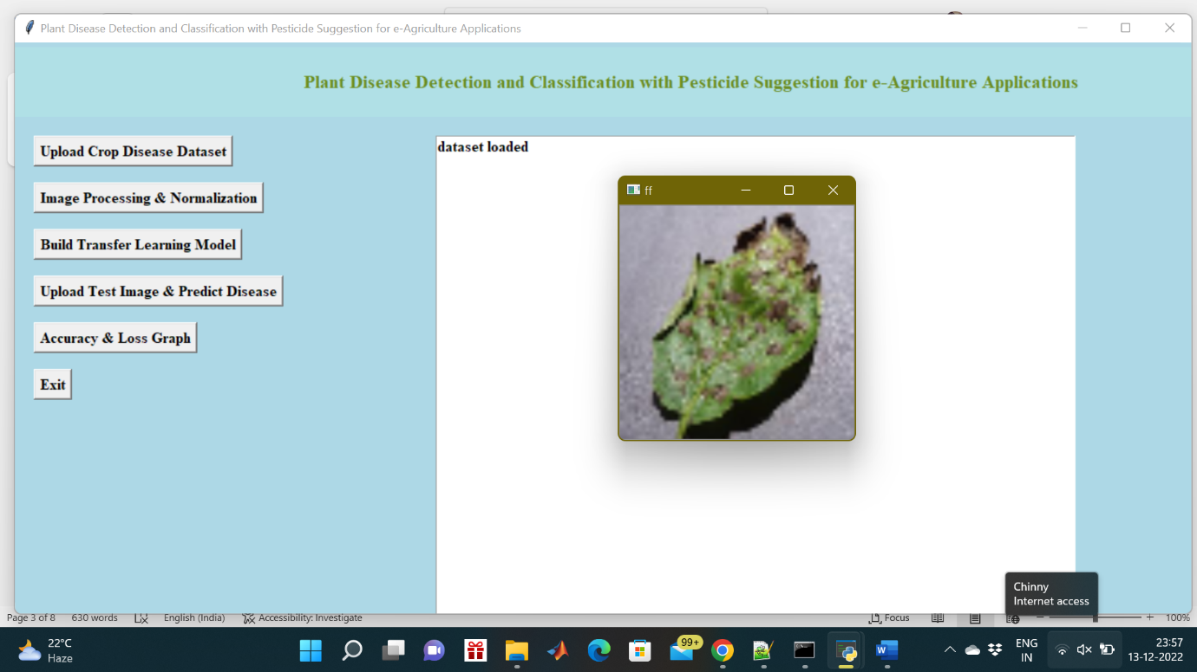
In above screen after applying normalization, we are just displaying one random image from dataset to check whether images loaded and process properly. Now dataset images are ready and now click on ‘Build Transfer Learning Model’ button to build CNN model.

Slide 27
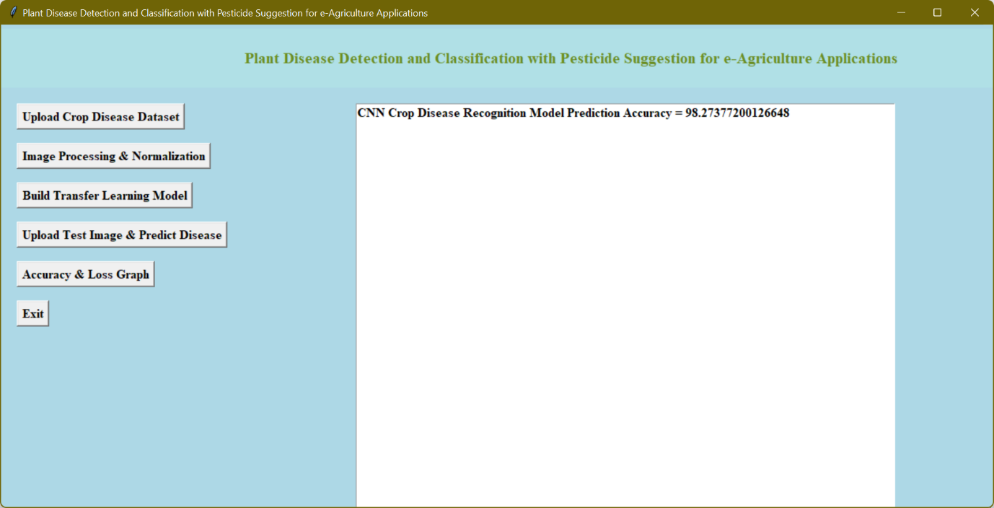
In above screen CNN model generated and its prediction accuracy is 98.27% and in below console screen we can see all CNN layers details

Slide 28
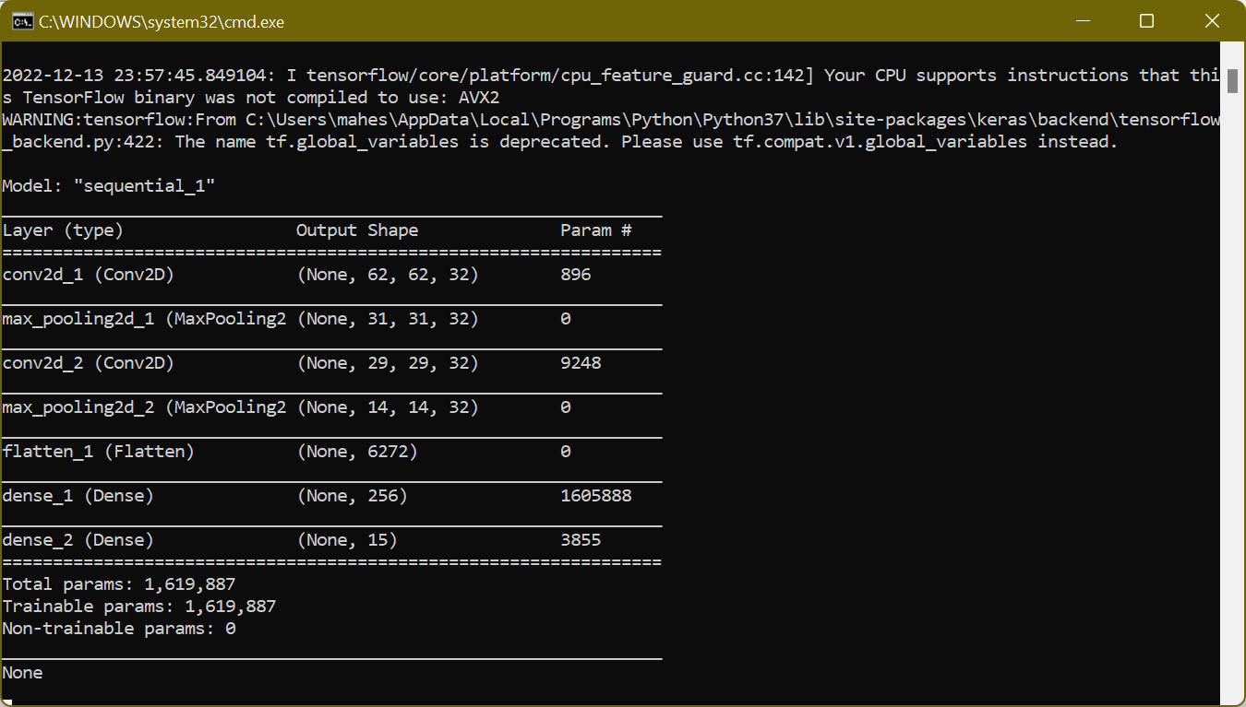
In above screen we can see we have used CONV2D, MAXPOOLING, FLATTEN and DENSE layer to build crop disease recognition model and RELU details you can see in code. Now model is ready and now click on ‘Upload Test Image & Predict Disease’ button to upload any test image and then application will predict disease or healthy from that image

Slide 29
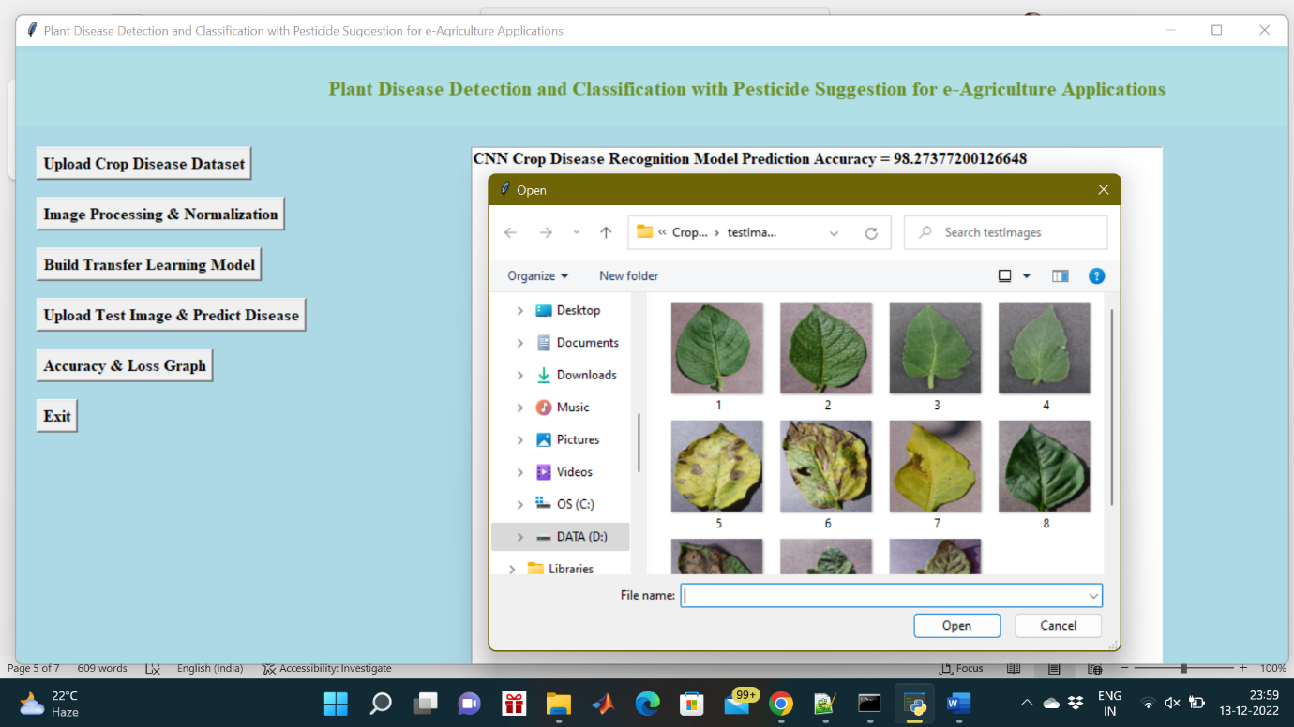
In above screen selecting and uploading ‘1.JPG’ image file and then click on ‘Open’ button to get below prediction result

Slide 30
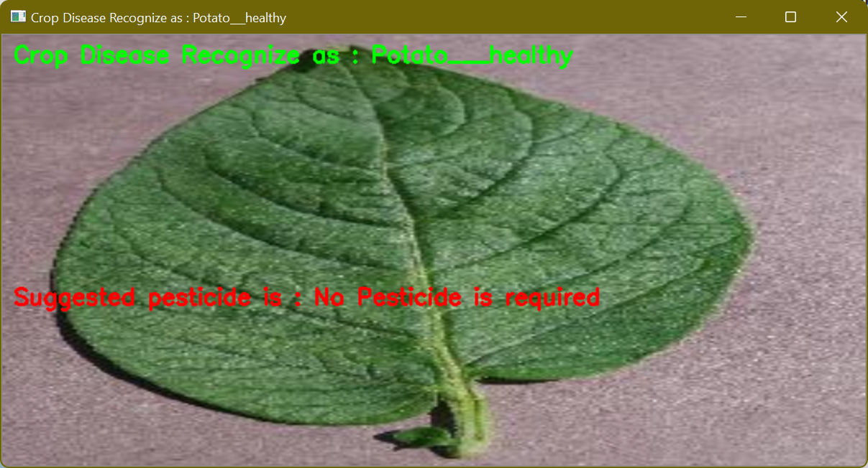
In above screen potato leaf predicted as healthy and pesticide suggested as no pesticide is required now try with other images.

Slide 31
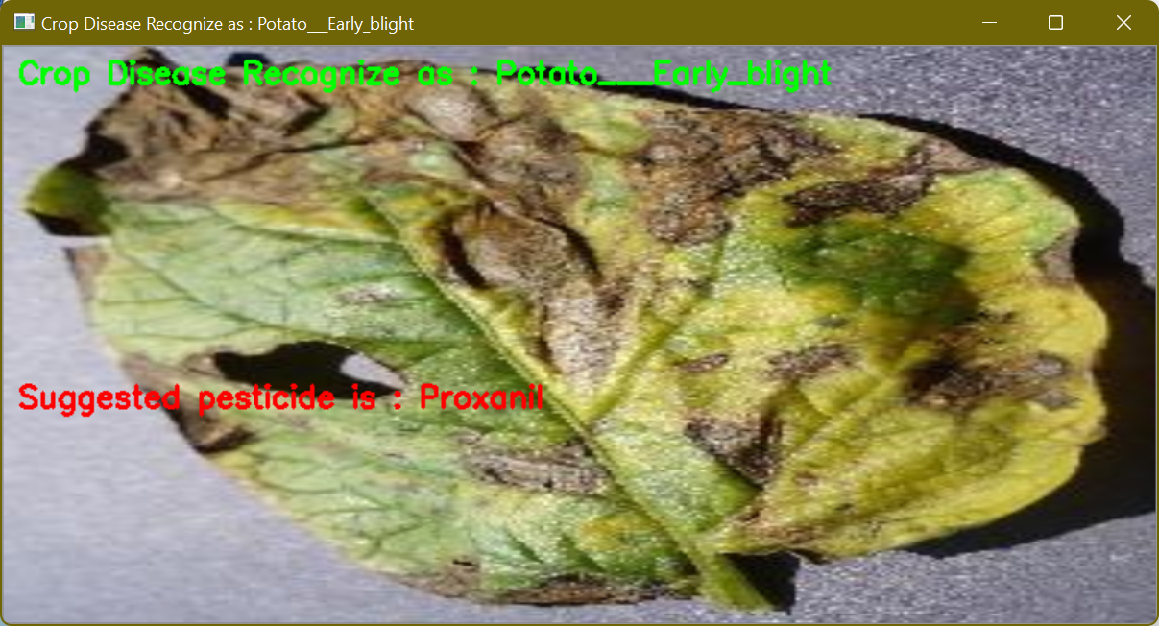
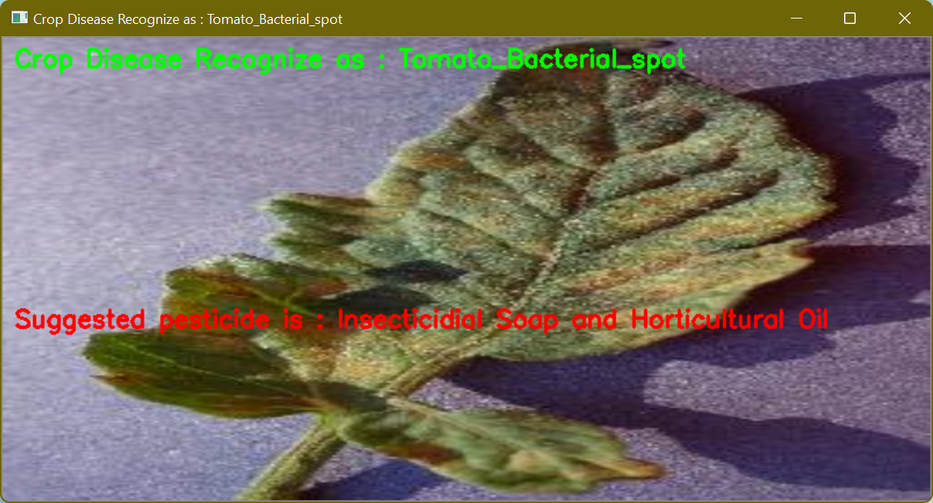

Slide 32
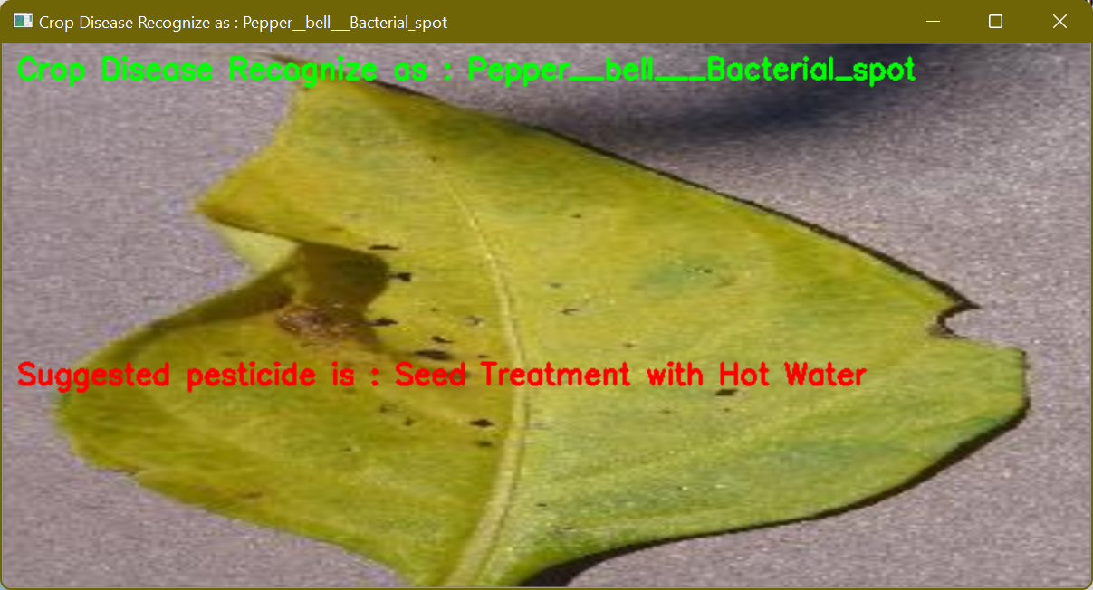
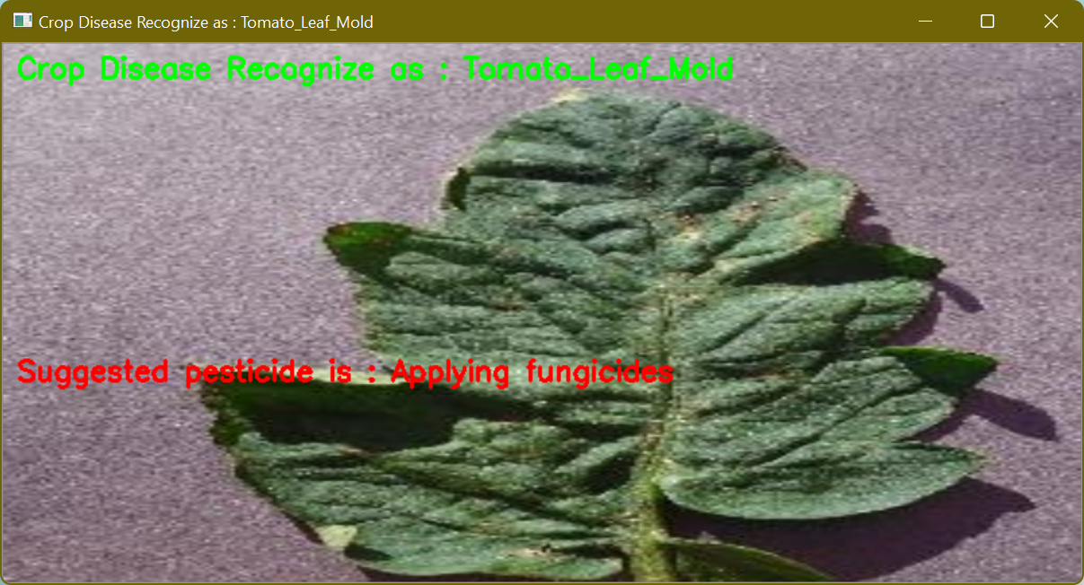
Now click on ‘Accuracy & Loss Graph’ button to get below graph

Slide 33
Future Enhancement
There are two directions should be improved, they are extended data set and optimized model. There are 27 diseases with 10 crop species dataset is available, and other species and diseases were not involved, such as rice and wheat, and their related diseases.
Therefore, the next step is to obtain more crop species and disease images for research. This model has achieved good recognition accuracy and is worthy of further study and optimization.
At the same time, we should design a network model which can classify crop images with higher accuracy.

Slide 34
Conclusion
In this work 15 kinds of crop diseases were studied. The model is constructed by using deep learning theory and ResNet-CNN technology.
Experiments show that the model can effectively identify the data set, and the overall recognition accuracy is as high as 98.23%. The results show that the recognition accuracy of this hybrid network model is relatively higher than the traditional model, and it can be effectively applied to the identification and detection of plant diseases.

Slide 35
THANK YOU !!!

